Slide 1
Ontology-based approach to modelling interdependency of critical infrastructure
YAN Jingya
Postdoctoral Researcher, ETH Zurich, Singapore-ETH Centre
Jingya.yan@frs.ethz.ch

Slide 2
Outlines
Motivation
Project structure
Methodology
Knowledge module
Data storage module
Implementation
Summary and further works

Slide 3
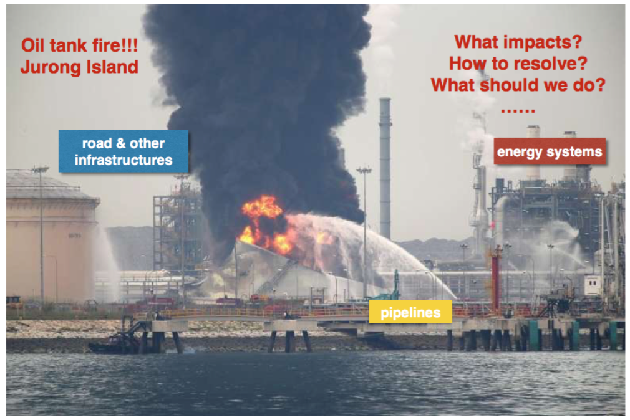
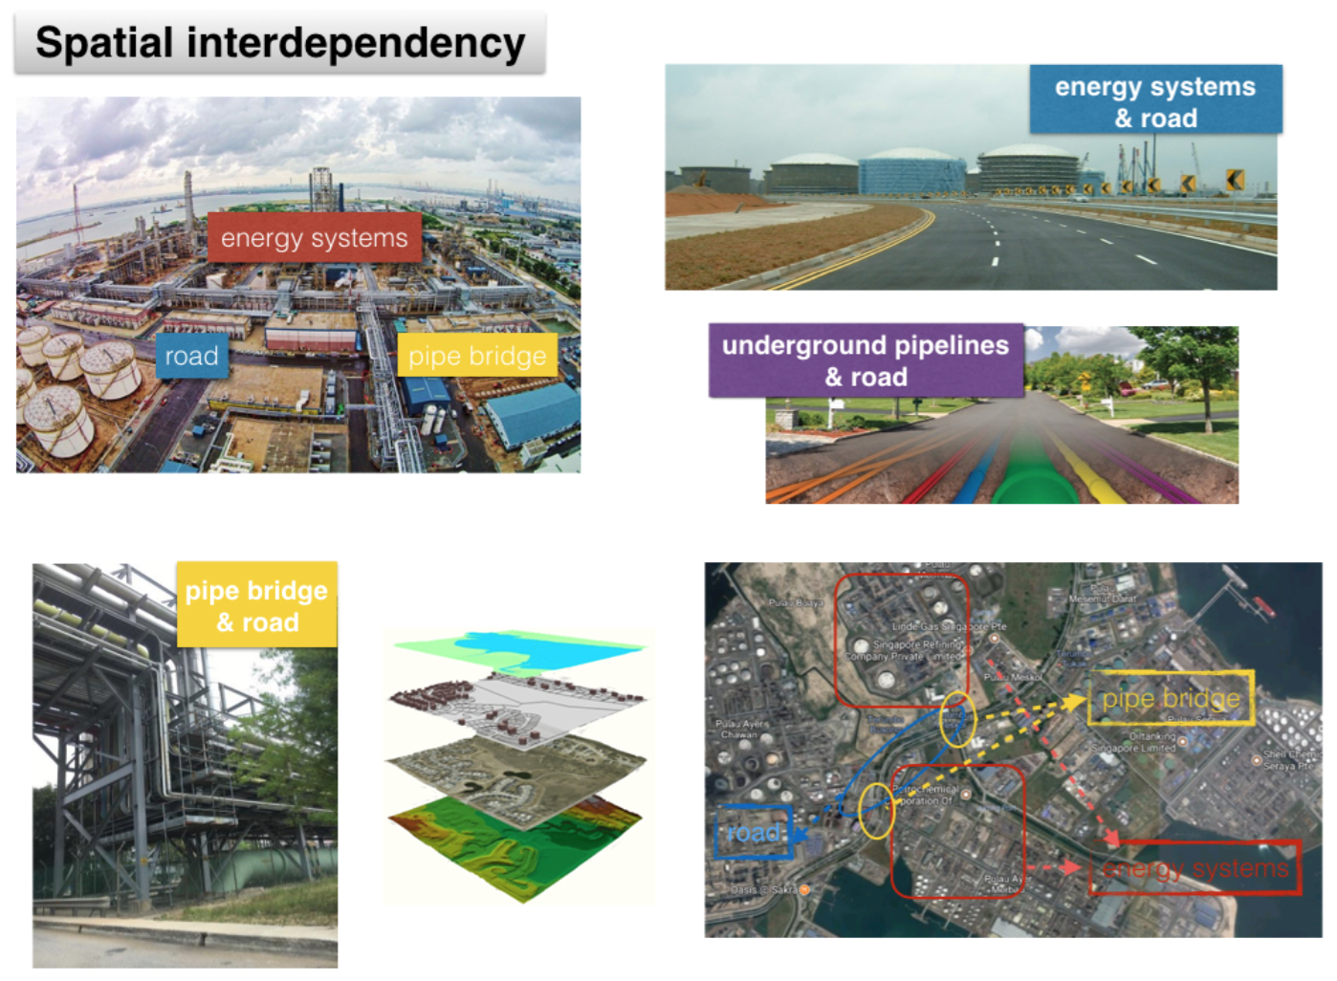
Motivation
Interdependencies among infrastructure systems made the system vulnerable to cascading failures, thus amplifying the impact of the initial failures into catastrophic proportions.
Urbanization has increased the complexity of the infrastructure systems.
An evolving understanding of the interdependencies among infrastructure systems.
Existing works mainly focus on the flow interdependencies.
Information of interdependencies and solutions have difficult to be represented in the information systems.

Slide 4
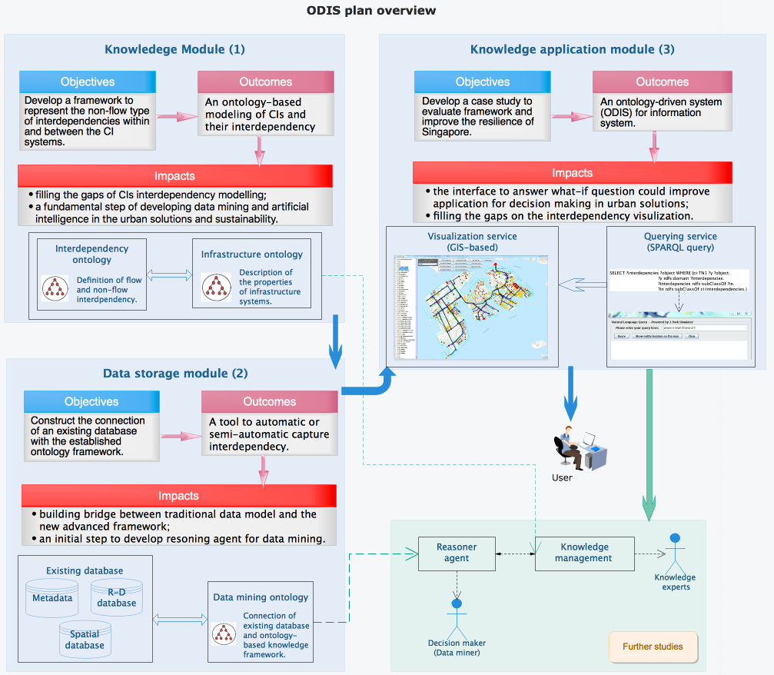
Project structure

Slide 5
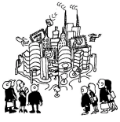
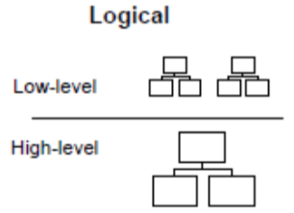
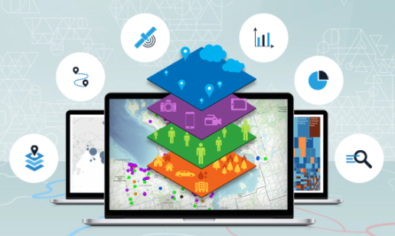
Method--Ontology
What categories are?
How they are specified?
How they are related to each other?
Creation of Ontologies
Ontologies OF information system: to create description of the different aspects of real world.
Ontologies FOR information system: to generate or validate information system components.
Real world
Conceptualization
Formalization
Use of Ontologies
Transformation
Ontologies OF information system
Support the creation of modelling tools
Ontologies FOR information system
Support the creation of ontology-driven information systems
Notes:
Ontology = high quality controlled structured vocabularies for the annotation (description, tagging) of data, images, documents…

Slide 6
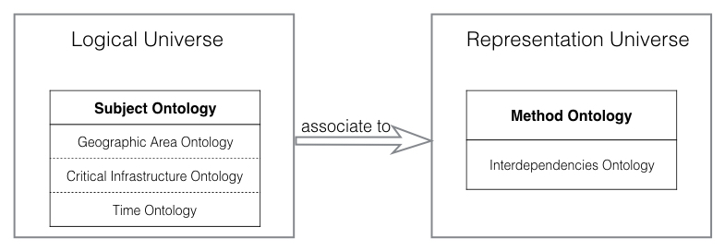
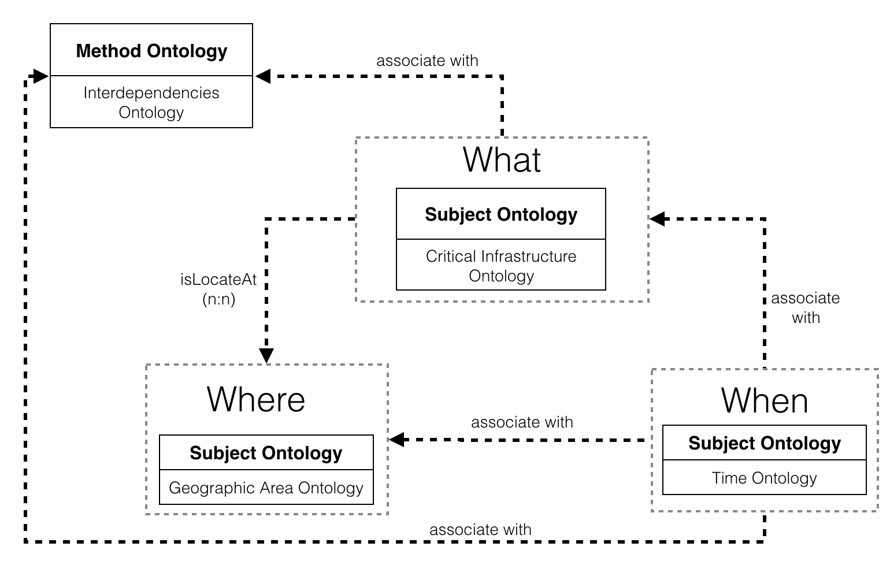
Knowledge module—Creation of ontology
Issues
The lack of models for non-flow interdependencies, especially spatial and logical interdependencies
The lack of a comprehensive framework to model and simulate all types of interdependencies.
An ontology-based approach
To model CIs with their properties and interaction within an CI component
Modeling of interdependencies among systems.
Separating ontologies is to emphasize the detection of spatio-temporal configurations of geographic phenomena, and reuse elements of the same ontology in different applications.
Notes:
Logical universe provides explicit ontologies formalising the human cognition.
Representation universe deals with the description of objects from the logical universe.

Slide 7
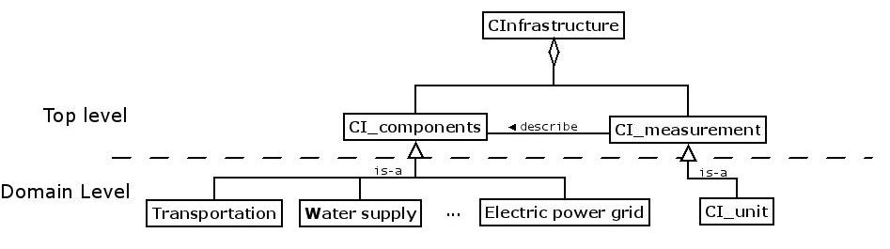
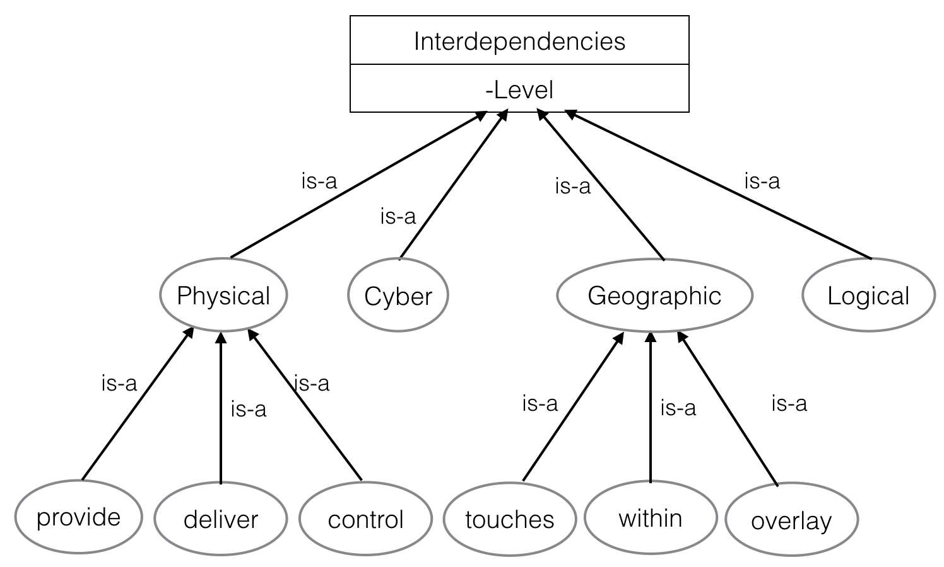
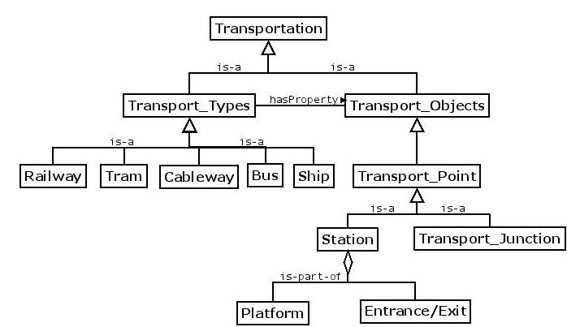
Knowledge module—Creation of ontology
Components of ontology
Concept: definition of the terms
Relations: is-a, is-part-of, etc.
Axioms: constraints or rules
Instances: real “things”
Notes:
Critical infrastructure ontology defines attributes and relationships of infrastructure components.
Interdependencies ontology defines different types of interdependencies and relationship between them.

Slide 8
Infrastructure interdependency modelling --Data storage module
R2RML
RDB to RDF Mapping Language
To generate RDF triples from a relational database based on specific mappings
Knowledge module
Data storage module
Existing database
Ontologies
(OWL)
Mappings
(R2RML)
Relational Database
Queries
(SPARQL)
Notes:
Reduce data redundancy

Slide 9
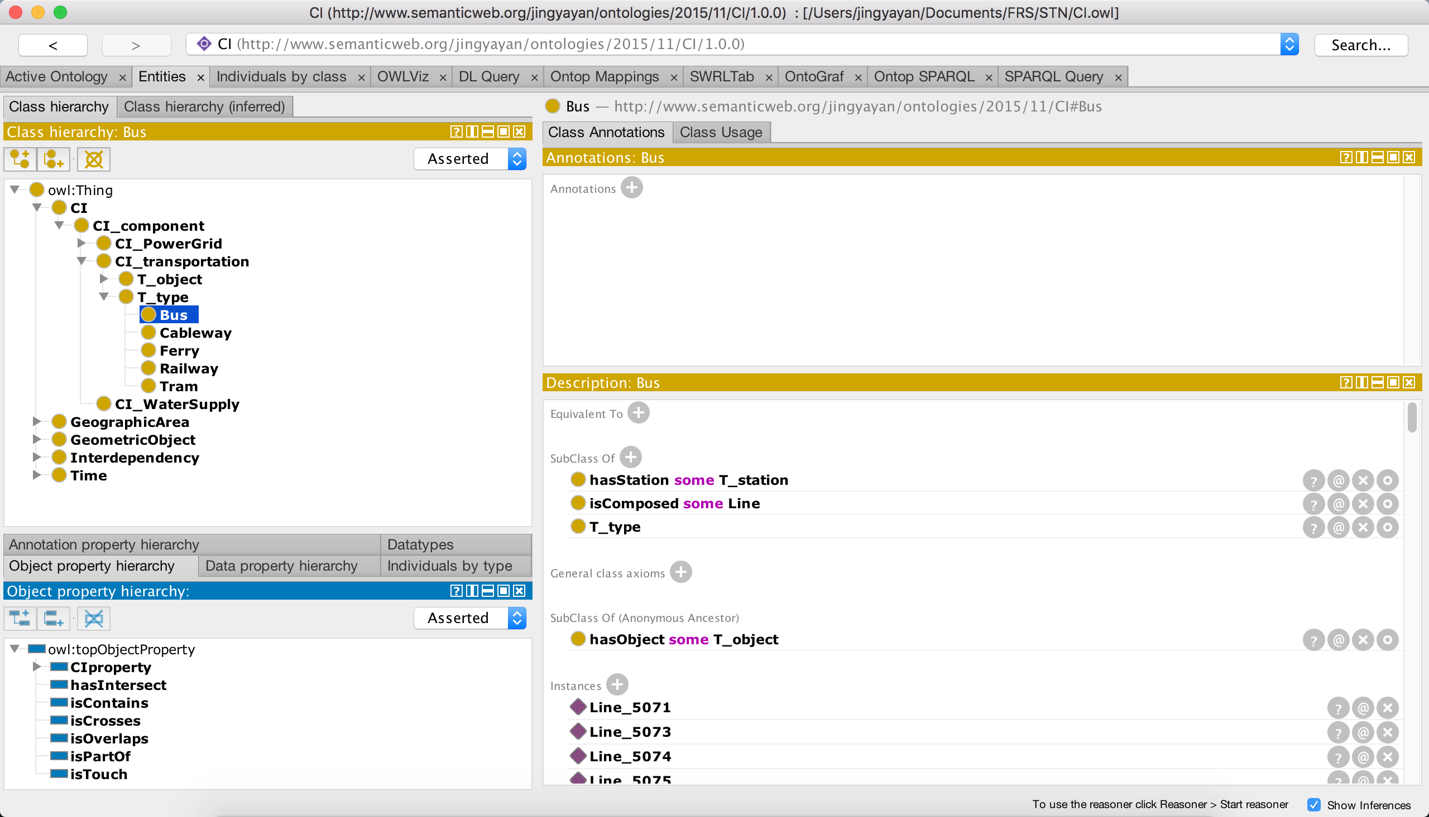
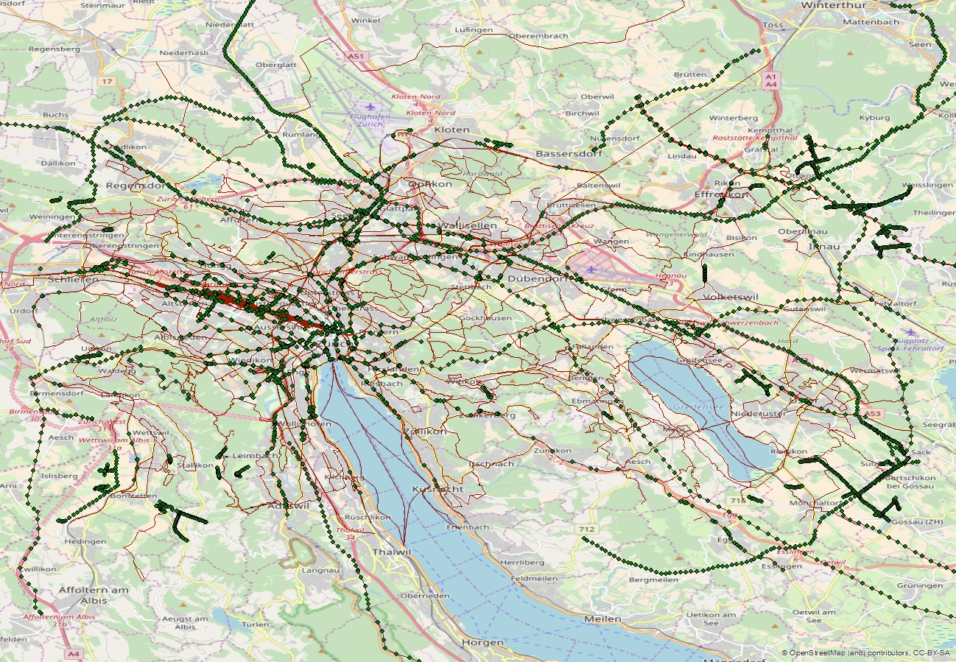
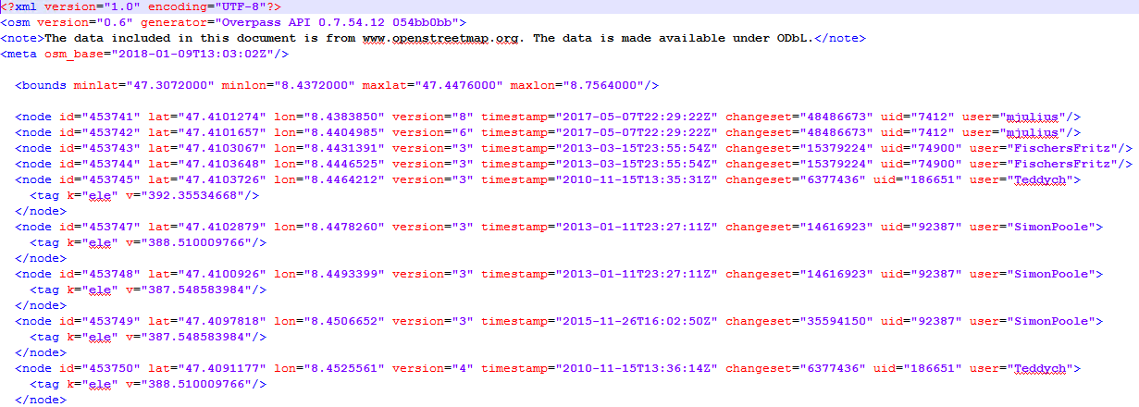
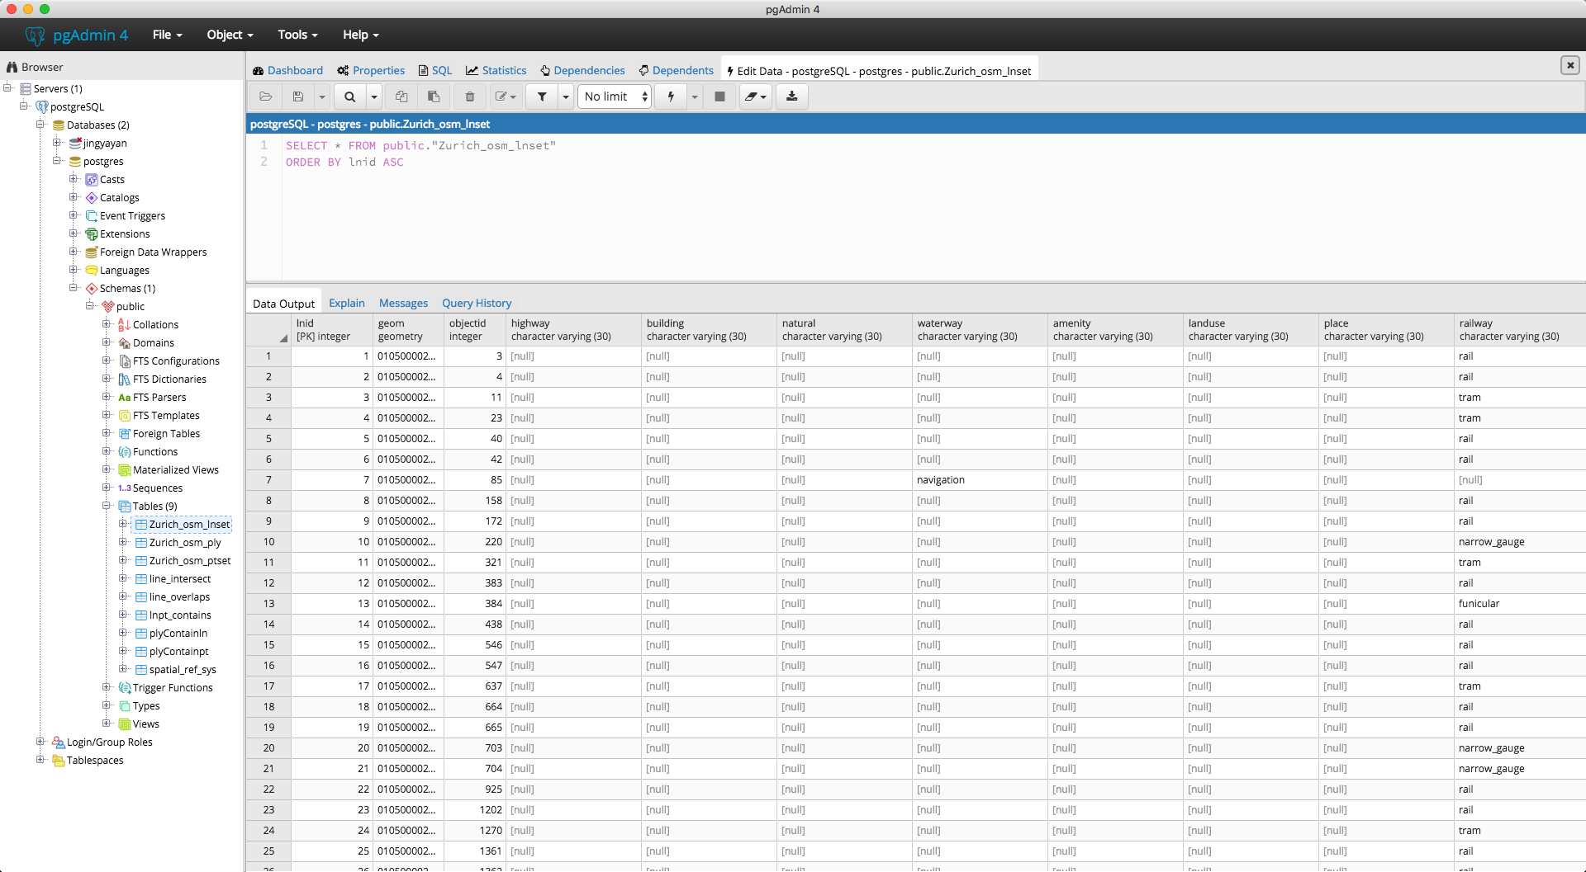
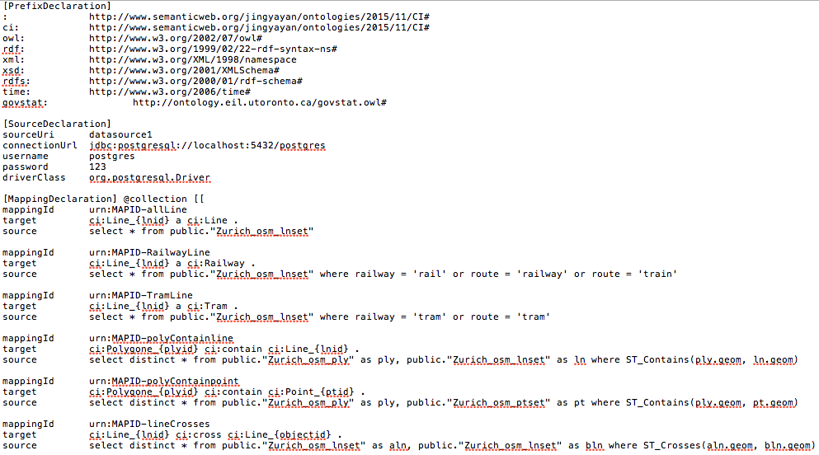
Infrastructure interdependency modelling --Implementation
CI interdependency
Ontologies
Openstreetmap
import
import
Demo
(Java)
PostgreSQL
Mappings

Slide 10
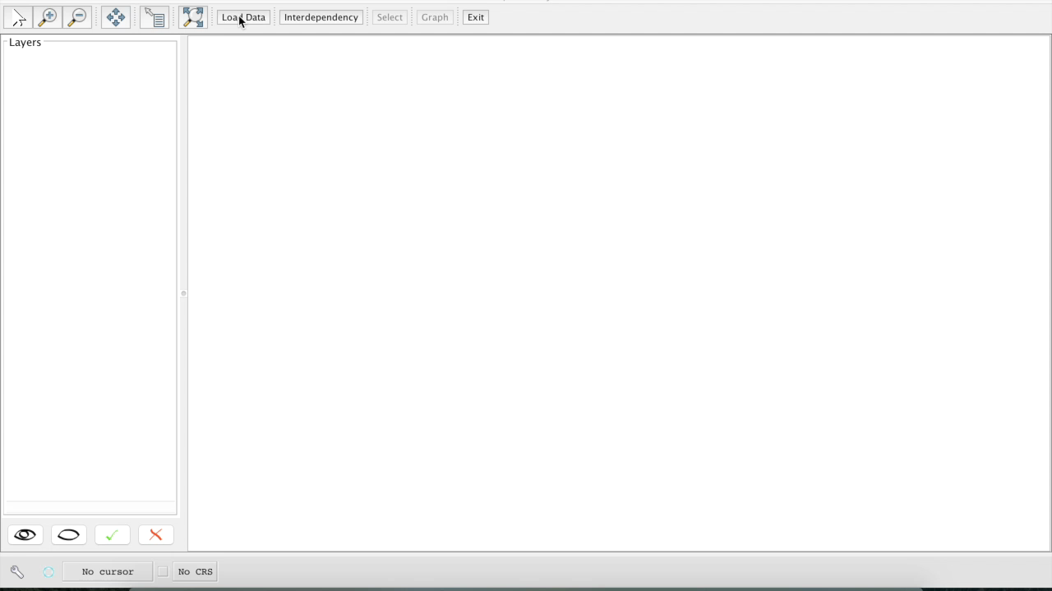
Infrastructure interdependency modelling --Demo

Slide 11
Summary and Further works
An initial design of ontologies in knowledge module.
The ontology framework can be easily extended to incorporate new features of the systems, thus it is adaptive to the future scenarios.
Further works
Knowledge module
The definition of interdependency should be improved
Application platform
To improve visulisation with web service
To improve querying service (e.g. multi-level)

Slide 12
Thank you Q & A

Slide 14
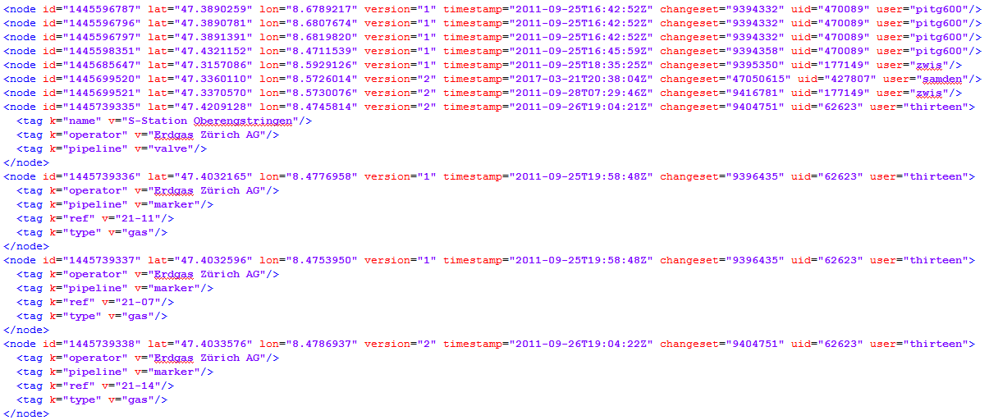

Slide 16
Ontop OBDA Model:
Based on R2RML
A specification of how the data in a data source is related to the vocabulary of an OWL or an RDFS ontology.
Data source declaration
Mapping axiom (source & target)

Slide 17
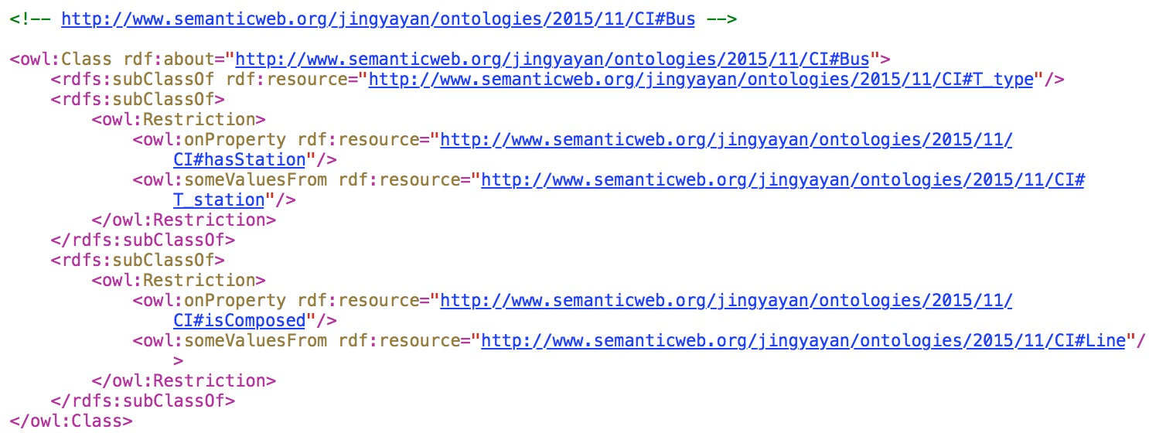
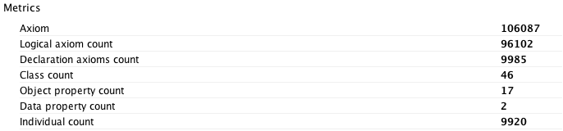
Notes:
RDF is a standard model for data interchange on the Web and written in XML. The RDF scheme provides basic elements to describe ontologies.

Slide 18
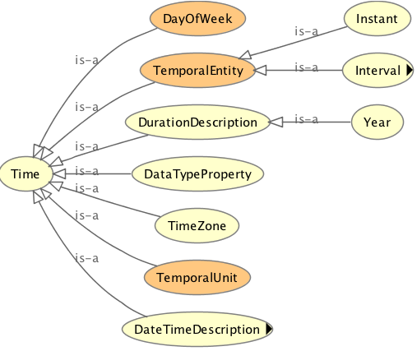
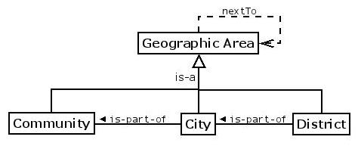
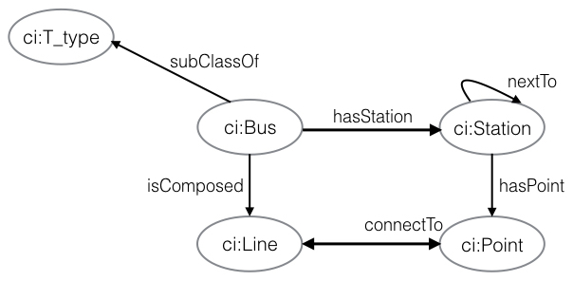
Knowledge module—Creation of ontology
Geographic area ontology defines attributes and subclasses to describe a geographic area.
Time ontology defines temporal knowledge and support to describe the time series of other concepts.
Example
A bus line has several
This bus line is composed by several line segments.
one station is related to one point.
A line connects to several points.

Slide 19
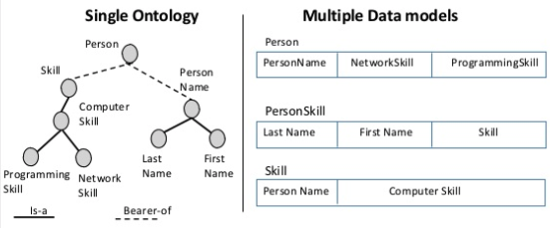
Methodology--Ontology
What is Ontology?
Ontology = high quality controlled structured vocabularies for the annotation (description, tagging) of data, images, documents…
 | Ontology | Database schema
Focus | Meaning Shared understanding | Data
Purposes | Communication, search, interoperability… | Structure instances for efficient storage and querying.
Instances | Optional | Central
Processing Engines | Theorem provers (infer new information, ensure consistency) | SQL Engines (querying, view, data integrity)
Roles of ontology:
A common vocabulary
Data sturcture
Explication of what is left implicit
Semantic interoperability
Explication of design rationale
Systematization of knowledge
Meta-model function
Theory of content
Notes:
Ontology = high quality controlled structured vocabularies for the annotation (description, tagging) of data, images, documents…

